Slide 1



Analyzing the Impact of Car Features on Price and Profitability
by Vaishnavi muthyam

Slide 2
project description
The automotive industry is strongly influenced by a large number of factors, including the features and specifications of a car model & continuously evolving with human preferences & technological advancements. This project aims to analyze how various car features—such as brand, engine fuel type, engine hp, engine cylinders transmission, fuel efficiency, no of doors, market category, vehicle style & size, popularity & price affect the pricing strategies and overall profitability .By examining the relationship between these features and car prices, It will provide us with valuable insights for car manufacturers, marketers, and stakeholders in the automotive industry, helping them optimize their product offerings, pricing strategies, and overall profitability by focusing on features that meet market demands..

Slide 3
approach
The approach for analyzing the impact of car features on price and profitability,
incorporated multiple steps, tools, and methods. This structured approach will allow us to derive insights from the given data Ensuring data quality by removing inconsistencies, handling missing values, and standardizing data formats whether it could be Computing basic summary statistics (mean, median, standard deviation)
Using charts, scatter plots, and histograms to visualize the relationships between different features (e.g., engine type, transmission type , fuel efficiency, car brands) and car prices.
performed Correlation Analysis to identify which features have a strong relationship with car prices.
Regression Analysis to quantify the impact of various car features on the car’s price. The model will include features as independent variables and car price as the dependent variable. Given tasks based on the business problem so it would require advanced Excel skills and knowledge of data analysis techniques such as regression analysis, pivot tables, and building an interactive dashboard, a data analyst could provide valuable insights to a car manufacturer and help them optimize their pricing and product development decisions to maximize profitability while meeting consumer demand.

Slide 4
Tech Stack Used
Microsoft Excel: For Data cleaning process, various Data analytical tools & skills to provide valuable insights
Microsoft Word: To Document everything what I’ve done during the process and how I gained so many insights dealt with advanced excel skills either it could be detecting a problem , having variety approaches , choosing what best works for a particular task , extracting and providing relative information required
Canva: To present, project presentations serves as an essential communication tool that helps present complex information in an understandable way

Slide 5
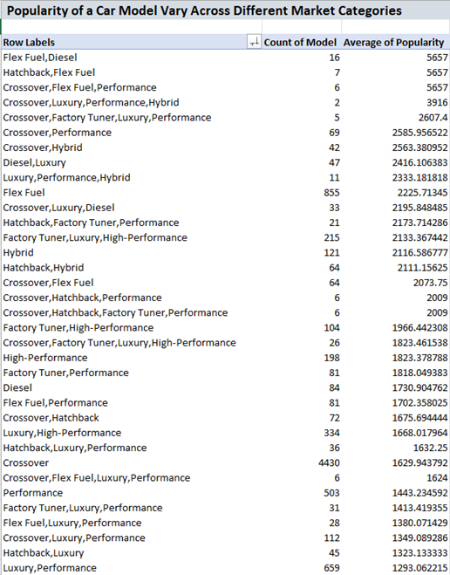
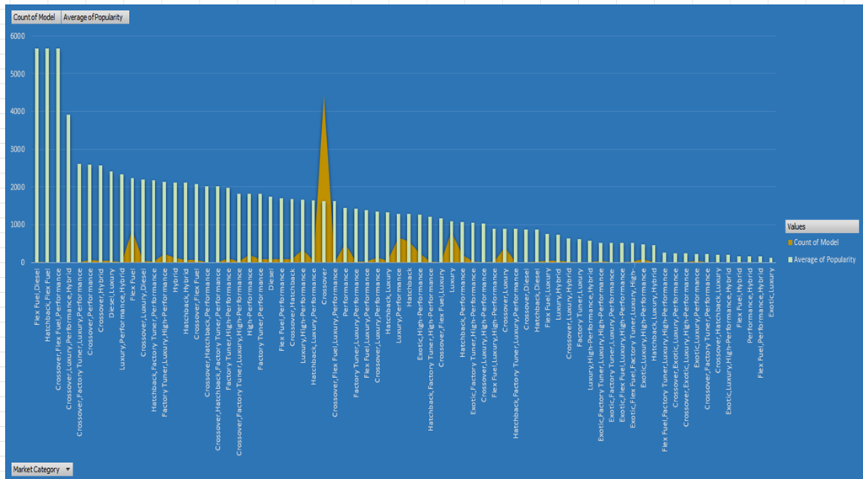
Analysis
How does the popularity of a car model vary across different market categories?

Slide 6
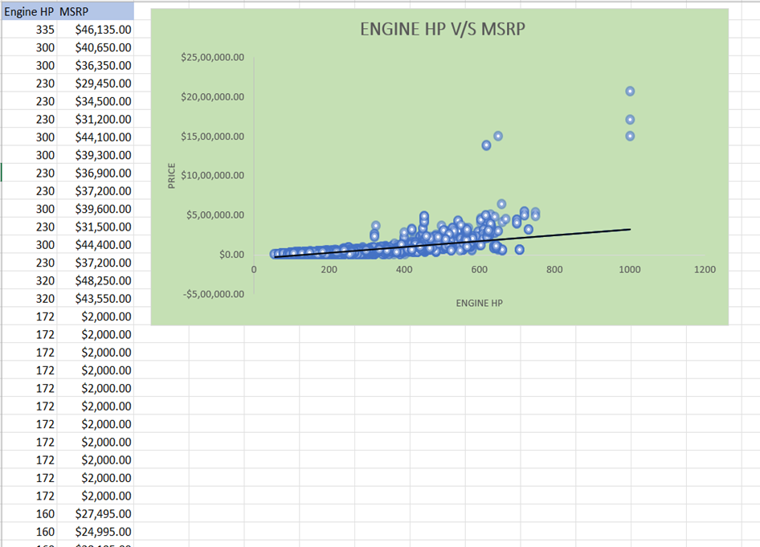
What is the relationship between a car's engine power and its price?

Slide 7
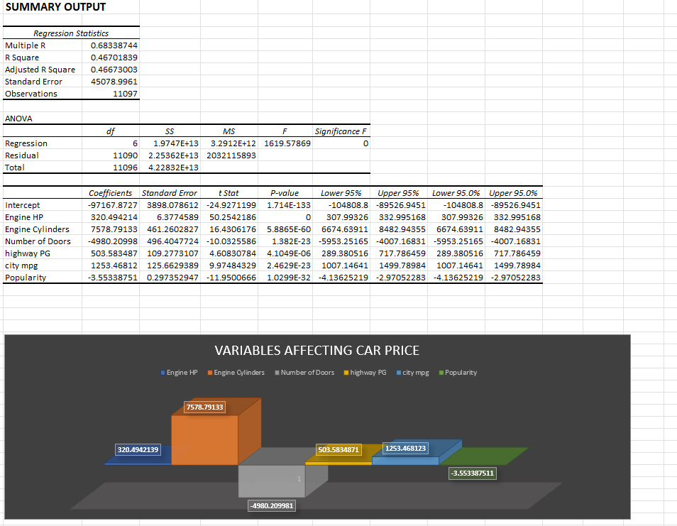
Which car features are most important in determining a car's price?

Slide 8
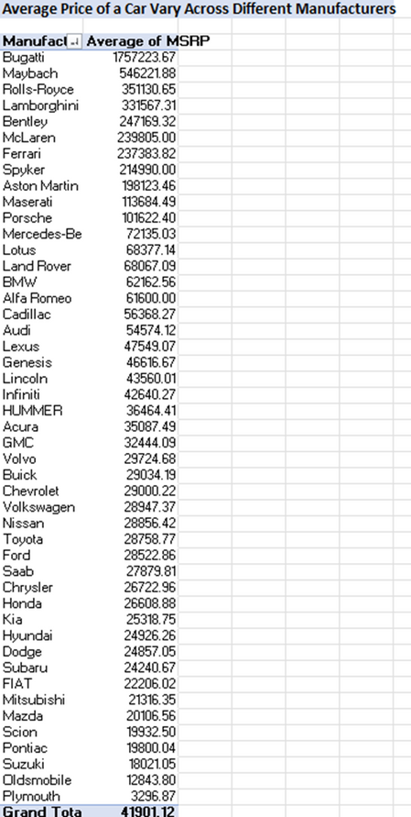
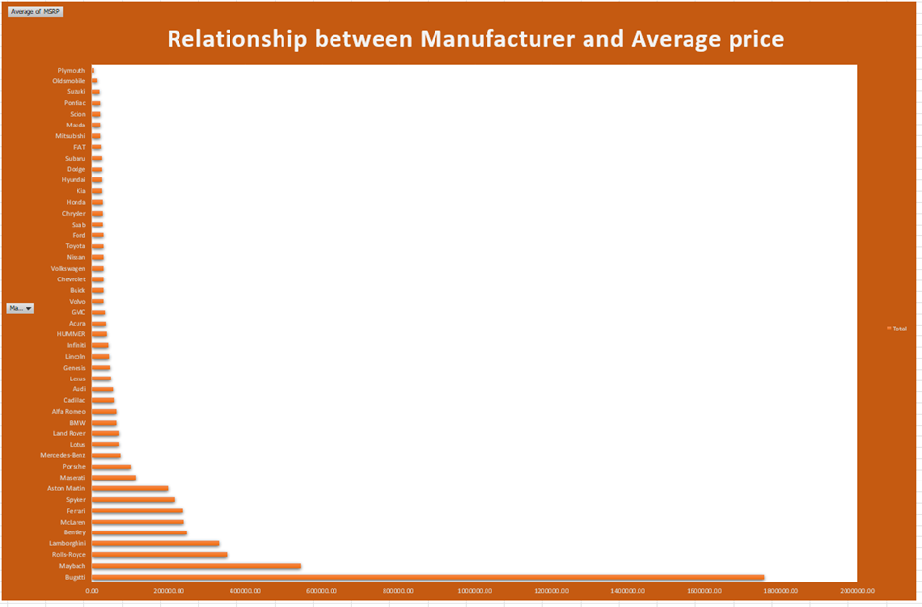
How does the average price of a car vary across different manufacturers?

Slide 9
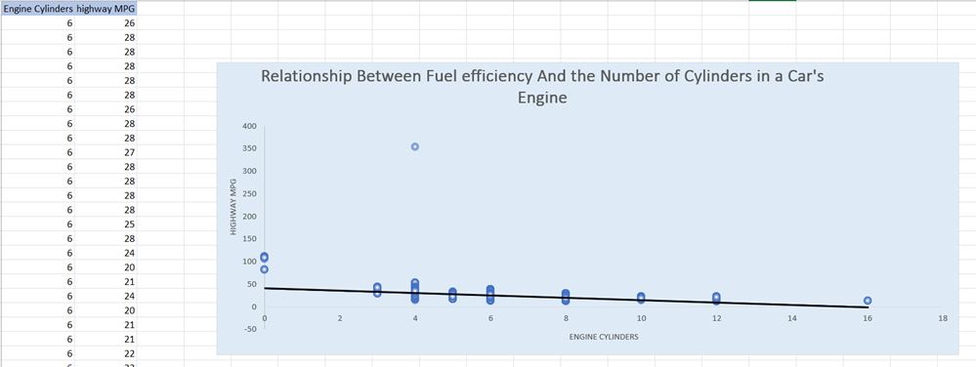

What is the relationship between fuel efficiency and the number of cylinders in a car's engine?

Slide 10
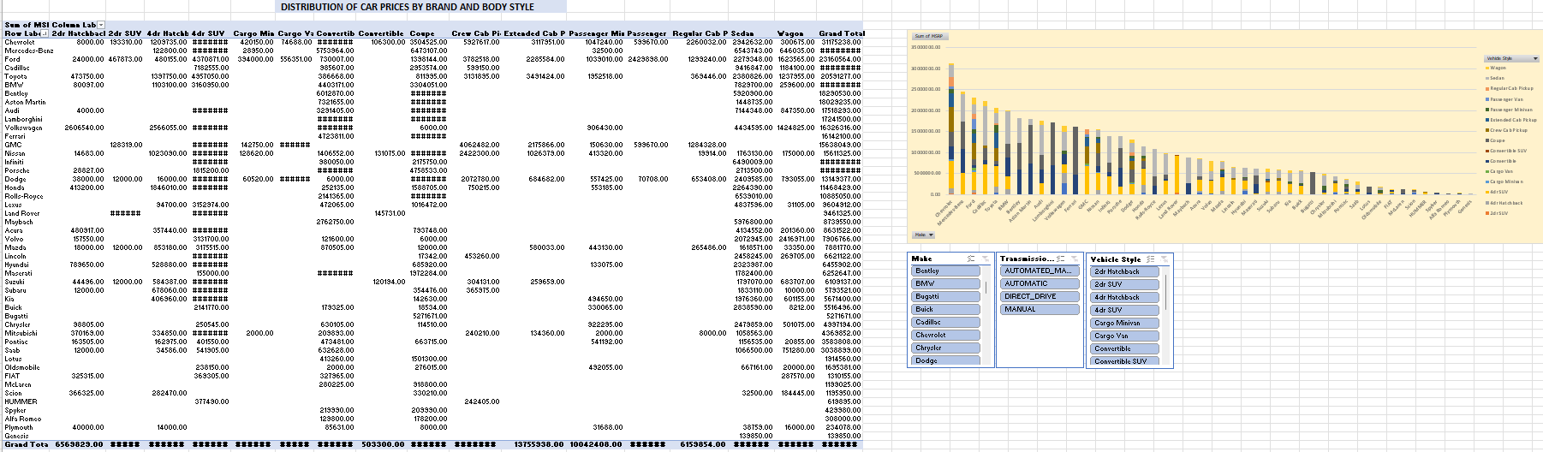
Building the Dashboard:
How does the distribution of car prices vary by brand and body style?

Slide 11
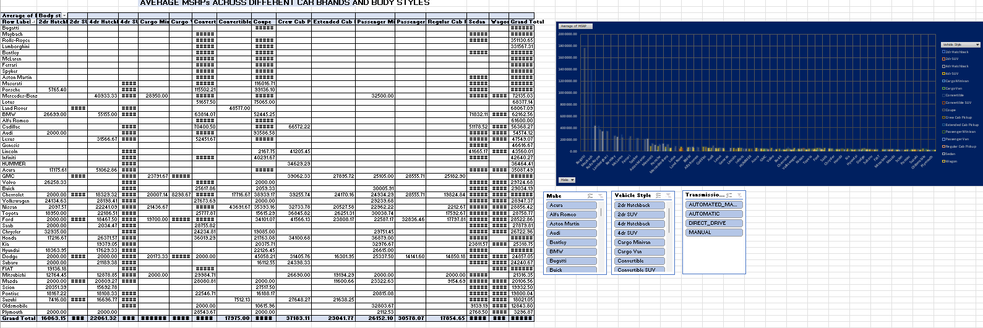
Which car brands have the highest and lowest average MSRPs, and how does this vary by body style?

Slide 12
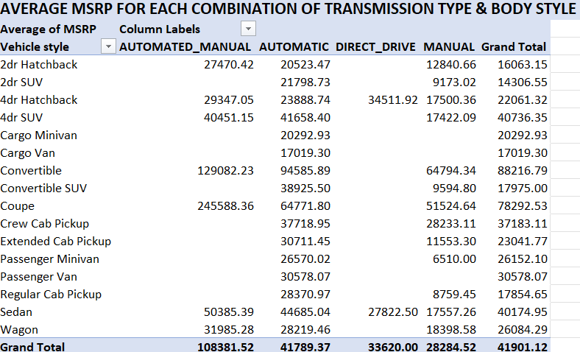
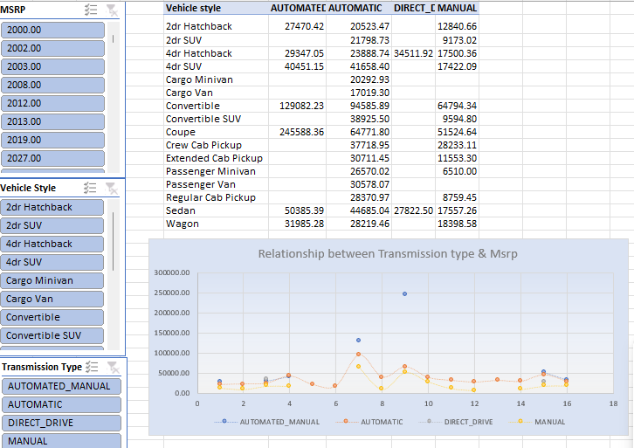
How do the different feature such as transmission type affect the MSRP, and how does this vary by body style

Slide 13
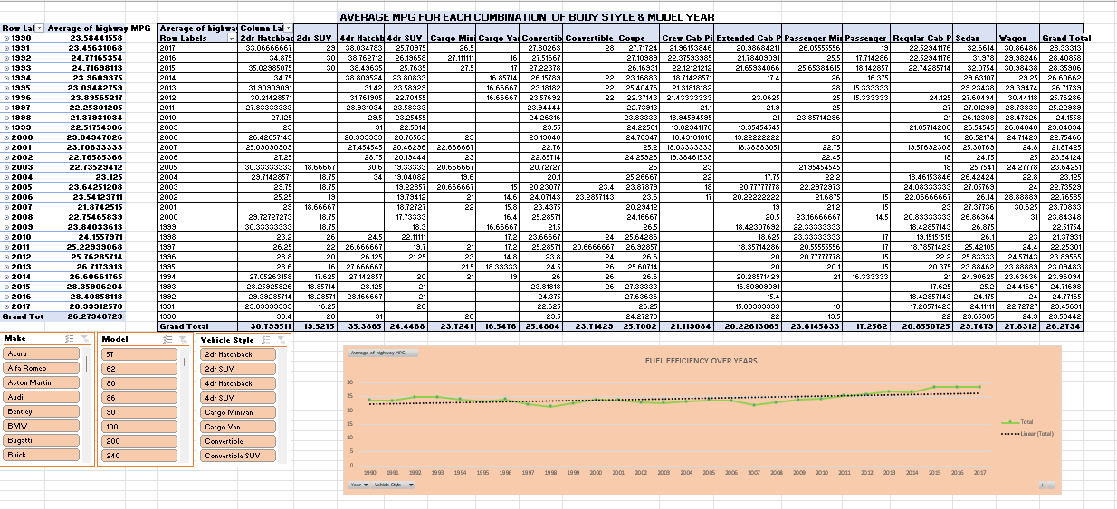
How does the fuel efficiency of cars vary across different body styles and model years?

Slide 14
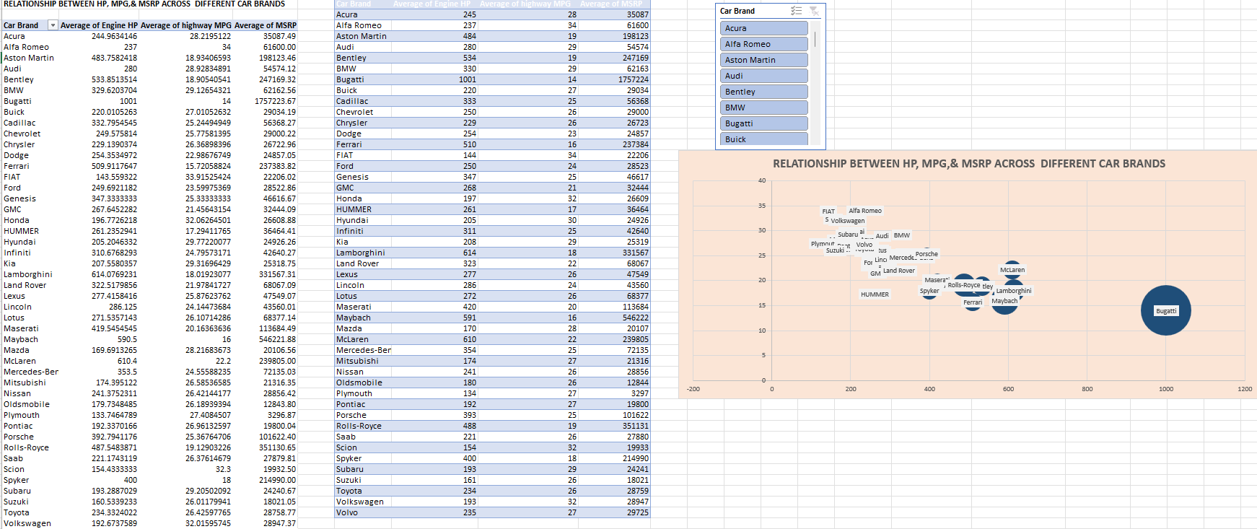
How does the car's horsepower, MPG, and price vary across different Brands?

Slide 15
Thank You

